Slide 1

Next Hike Solutions
PROJECT - 2
Data Filtering, Merging and Visualization
- : Presentor :-Preyanshi Pancholi

Slide 2
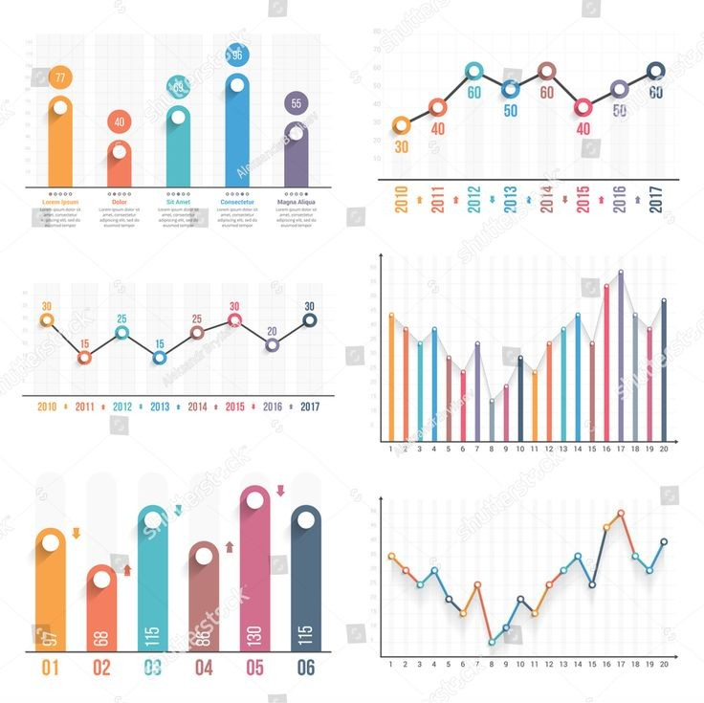
Project Vision, Functionalities & Uniqueness
Data Filtering , Merging and Visualization for better understanding
01.
Visualize the data so any one can have a insights regarding that
02.
Use of different libraries
Create different plot like LinePlot, BarPlot, HistogramPlot and HeatMap
03.

Slide 3
Libraries and their Fucntionality
Pandas :
For importing Data, Data Cleaning, Data Merging, Data Classification and Data Exporting
Scipy.Stats :
For Calculation of Skewness & Kurtosis
Numpy :
For Numeric Calculation life IQR, Percentile and Searching the Outliers
Matplotlib.Pyplot :
For Ploting the Graph, Applying the different methods to the Plot and make Visualization more designing
Seaborn :
For Ploting the different Plot like Bar Plot, Line Plot, Histogram and HeatMap

Slide 4
Challenges & Solutions
Challenges :-
Solutions :-
🔍 1. Data Filtering
Missing or NaN values affect filtering logic
Complex filtering conditions are hard to write and debug
Case sensitivity causes string mismatches
🔗 2. Data Merging
Mismatched or non-unique keys result in incorrect merges
Performance issues with large datasets
Column name conflicts (e.g., _x, _y suffixes after merge)
📈 3. Data Visualization
Overplotting makes graphs unreadable with large datasets
Misleading axis scales distort data representation
Missing labels, legends, or poor formatting affect clarity
🔍 1. Data Filtering
Use .dropna() or .fillna() to handle missing values
Use clear logical operators (&, |) with parentheses
Normalize strings with .str.lower() and .str.strip()
🔗 2. Data Merging
Ensure consistent key types with .astype(str)
Optimize memory with .astype('category') or use Dask for large data
Resolve name conflicts with suffixes=('_left', '_right') in merge()
📈 3. Data Visualization
Sample or aggregate data (df.sample()) to reduce overplotting
Apply log scales (plt.yscale('log')) or set axis limits
Add clear titles, labels, and rotate ticks for readability

Slide 5
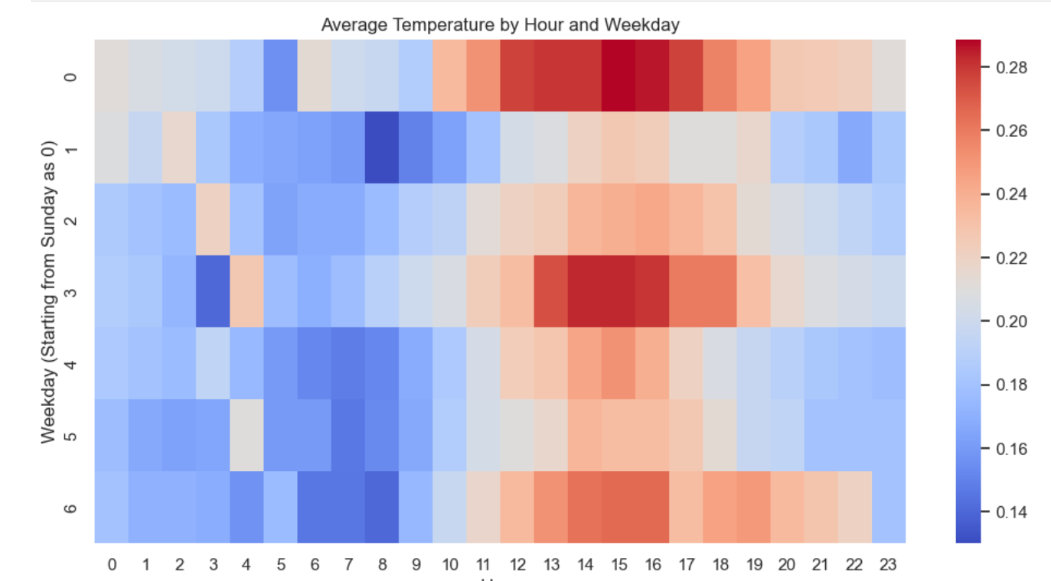
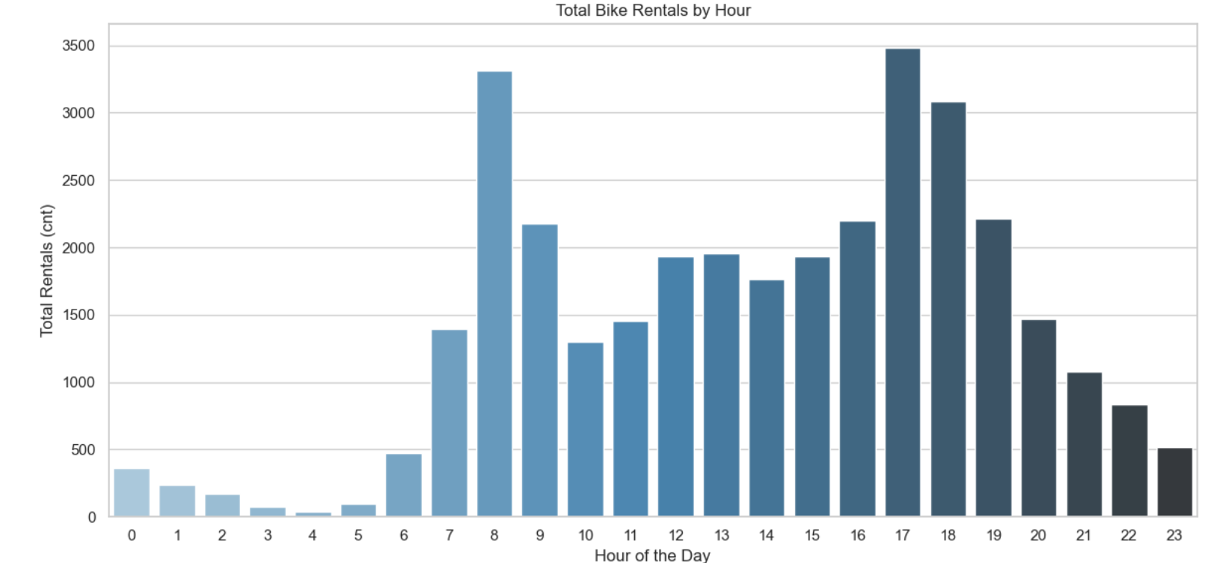
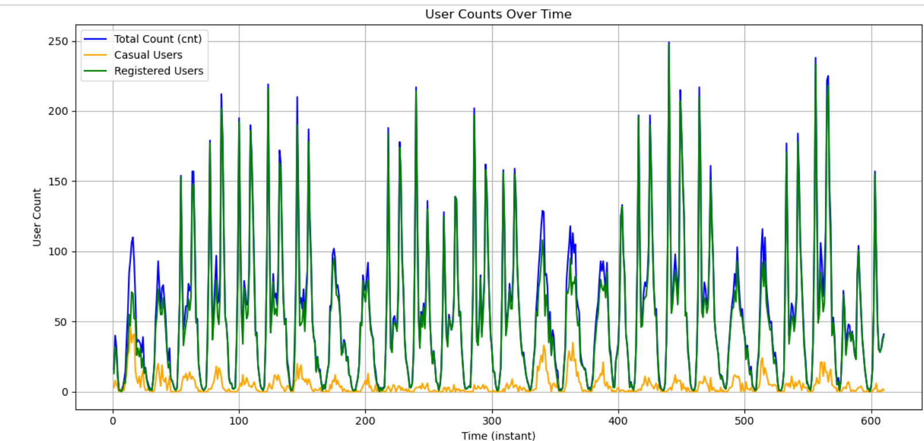
DATA VISUALIZATION

Slide 6
THANK YOU
Data Visualization Presentation

